Slide 1
Buds – Sprint 2
Workflow Management System

Slide 2
Team Roles
Sophie – SCRUM Master; Help on front/ back end
Gavin and Noah M – Back end
Noah B – Front end

Slide 3
Project Overview
Track the flow of raw materials all the way to the finished products to be sent out
Create a login screen and registration page that can be kept track of
Track stock management, product management, quality assessments, and delivery management
Create a report based on the information tracked by the database

Slide 4
Goals For Sprint 2
Connect our Azure database to Visual Studio
Continue to develop C# skills through class demos
Refine GUI – Make it so specific employees have specific access according to their job
Work on Classes in C#
Create a login table in our database

Slide 5
Goals Accomplished
Database is connected to Visual Studio
Our entire group completed the two in class demos
Refine GUI
Work on Classes in C#
Create a login table in our database

Slide 6
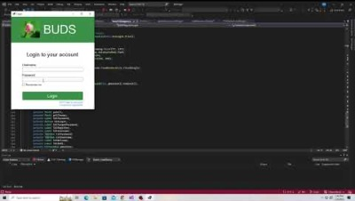
Login demo

Slide 7
Challenges
Spent longer than originally anticipated on connecting VS to Azure
Working out kinks with SqlConnection objects
Challenges with Visual Studio
GitHub - Pushing and pulling changes
Setting up classes to access the database and classes that hold user information across forms

Slide 8
Next Steps
Continue implementing Classes and Roles to provide unique functionality to each User Role within the Workflow system
Work out kinks with SqlConnection object
Figure out how to better pass user information from form to form
Begin implementation of product management/ stock management aspect of the project

Slide 9
Questions?

